Slide 1
JET Audio Encoder
Taylor Autry
Eric Addison
Josh Musick

Slide 2
Overview
Compression Pipeline
Metrics Evaluated
Filter Bank
Modified Discrete Cosine Transform (MDCT)
Byte Bufferizers
Huffman Encoder
Serialization

Slide 3
Audio Compression Pipeline
Input Audio File (wav)
Modified Discrete Cosine Transform (MDCT)
Filter Bank
Line Byte Bufferizer
Sub Band Byte Bufferizer
Huffman Encoder
Serialize Data Stream
Output Compressed File (jet)

Slide 4
Metrics Evaluated
Compress / Decompress Time
Compression Ratio (input size vs output size)
RMS Error

Slide 5
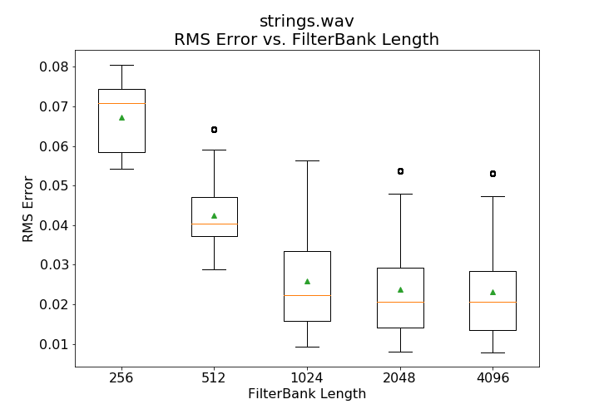
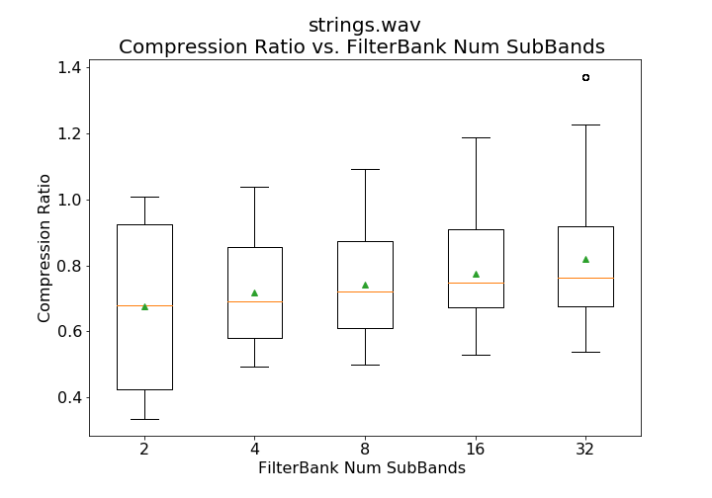
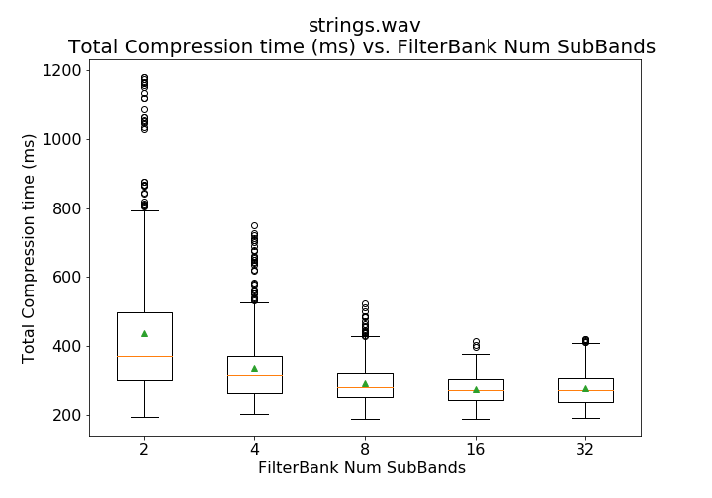
Filter Bank Step
Variable Parameters
Filter-bank Length
Number of Sub-bands

Slide 6
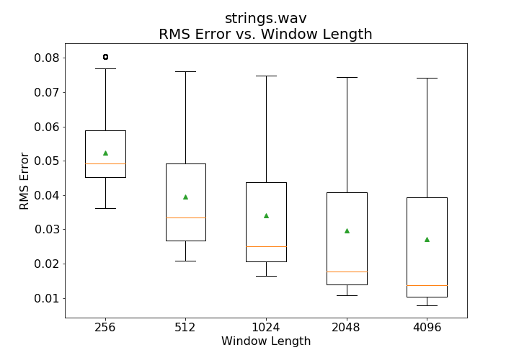
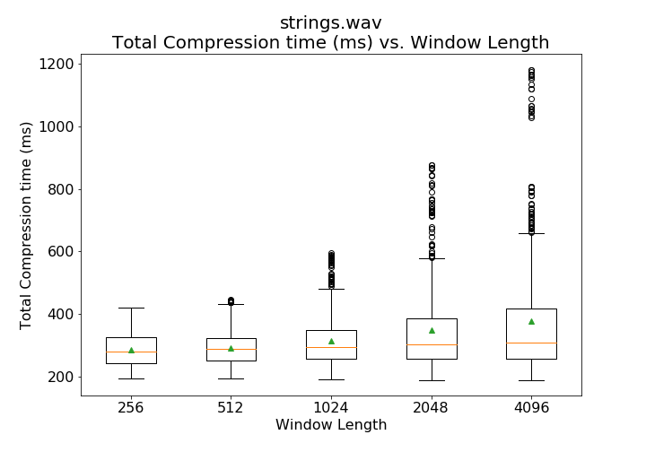
Filter Bank Step (cont.)
Variable Parameters
Window Length

Slide 7
Modified Discrete Cosine Transform
Separates sub-bands into smaller bands using Fourier transforms
Eliminates frequencies too close to distinguish
This wasn’t used in the test suite

Slide 8
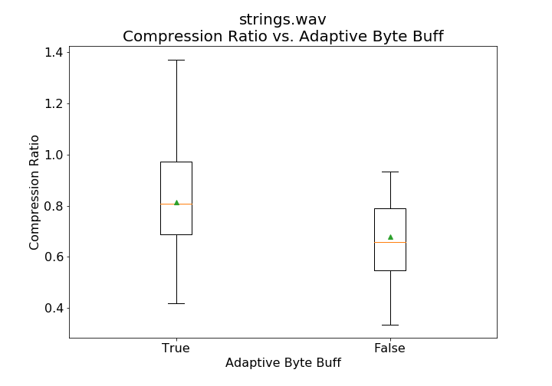
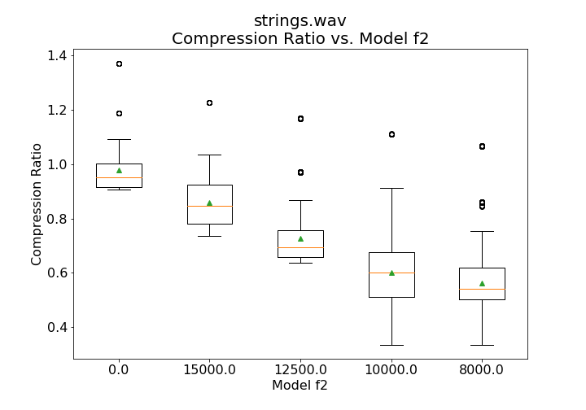
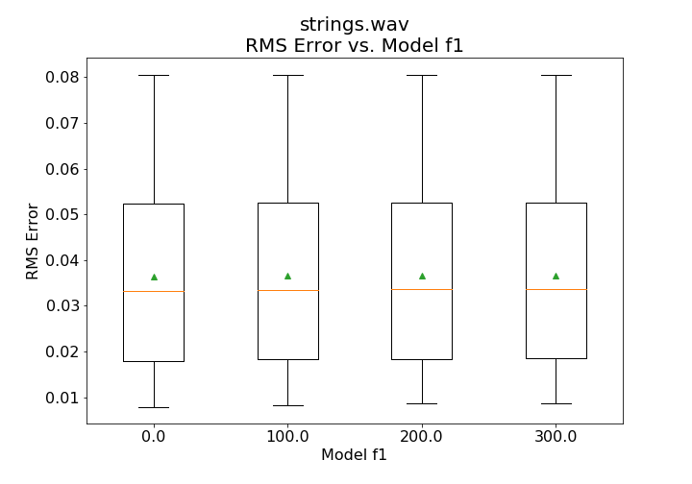
Byte Bufferizers
Pseudo-Acoustic Model
Adaptive vs Non-Adaptive

Slide 9
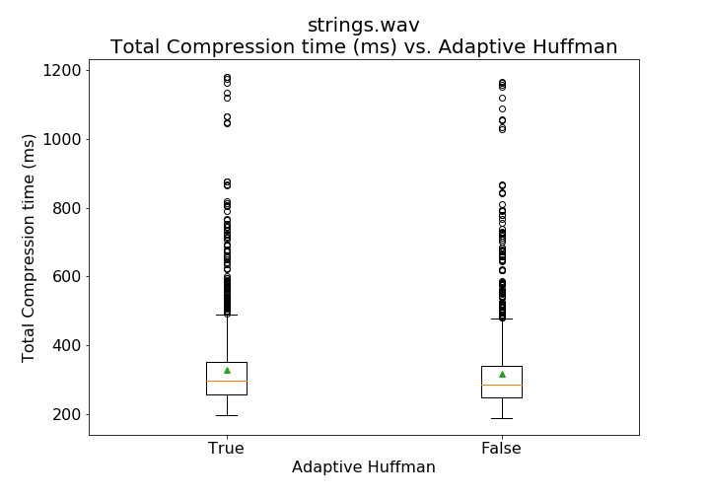
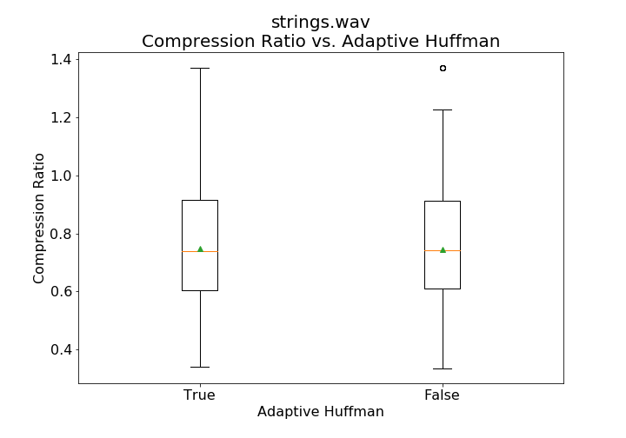
Huffman Encoder
Adaptive Encoding

Slide 10
Data Serialization
Writing data to binary file
No standard format was used
Enabled quick writing and reading

Slide 11
Summary
Compression Pipeline
Metrics Evaluated
Filter Bank
Modified Discrete Cosine Transform (MDCT)
Byte Bufferizers
Huffman Encoder
Serialization

